Slide 1
Investigation of Image Classification based on Transfer Learning and Siamese Network
Ke Fan, Abdullateef Almudaifer, Sungman Kang

Slide 2
Agenda
Objective
Transfer Learning
Siamese Network
Dataset Processing
Implementation
Evaluation
SCHOOL OF - to apply in all slides at the same time edit in Insert > Header & Footer

Slide 3
Objective

Slide 4
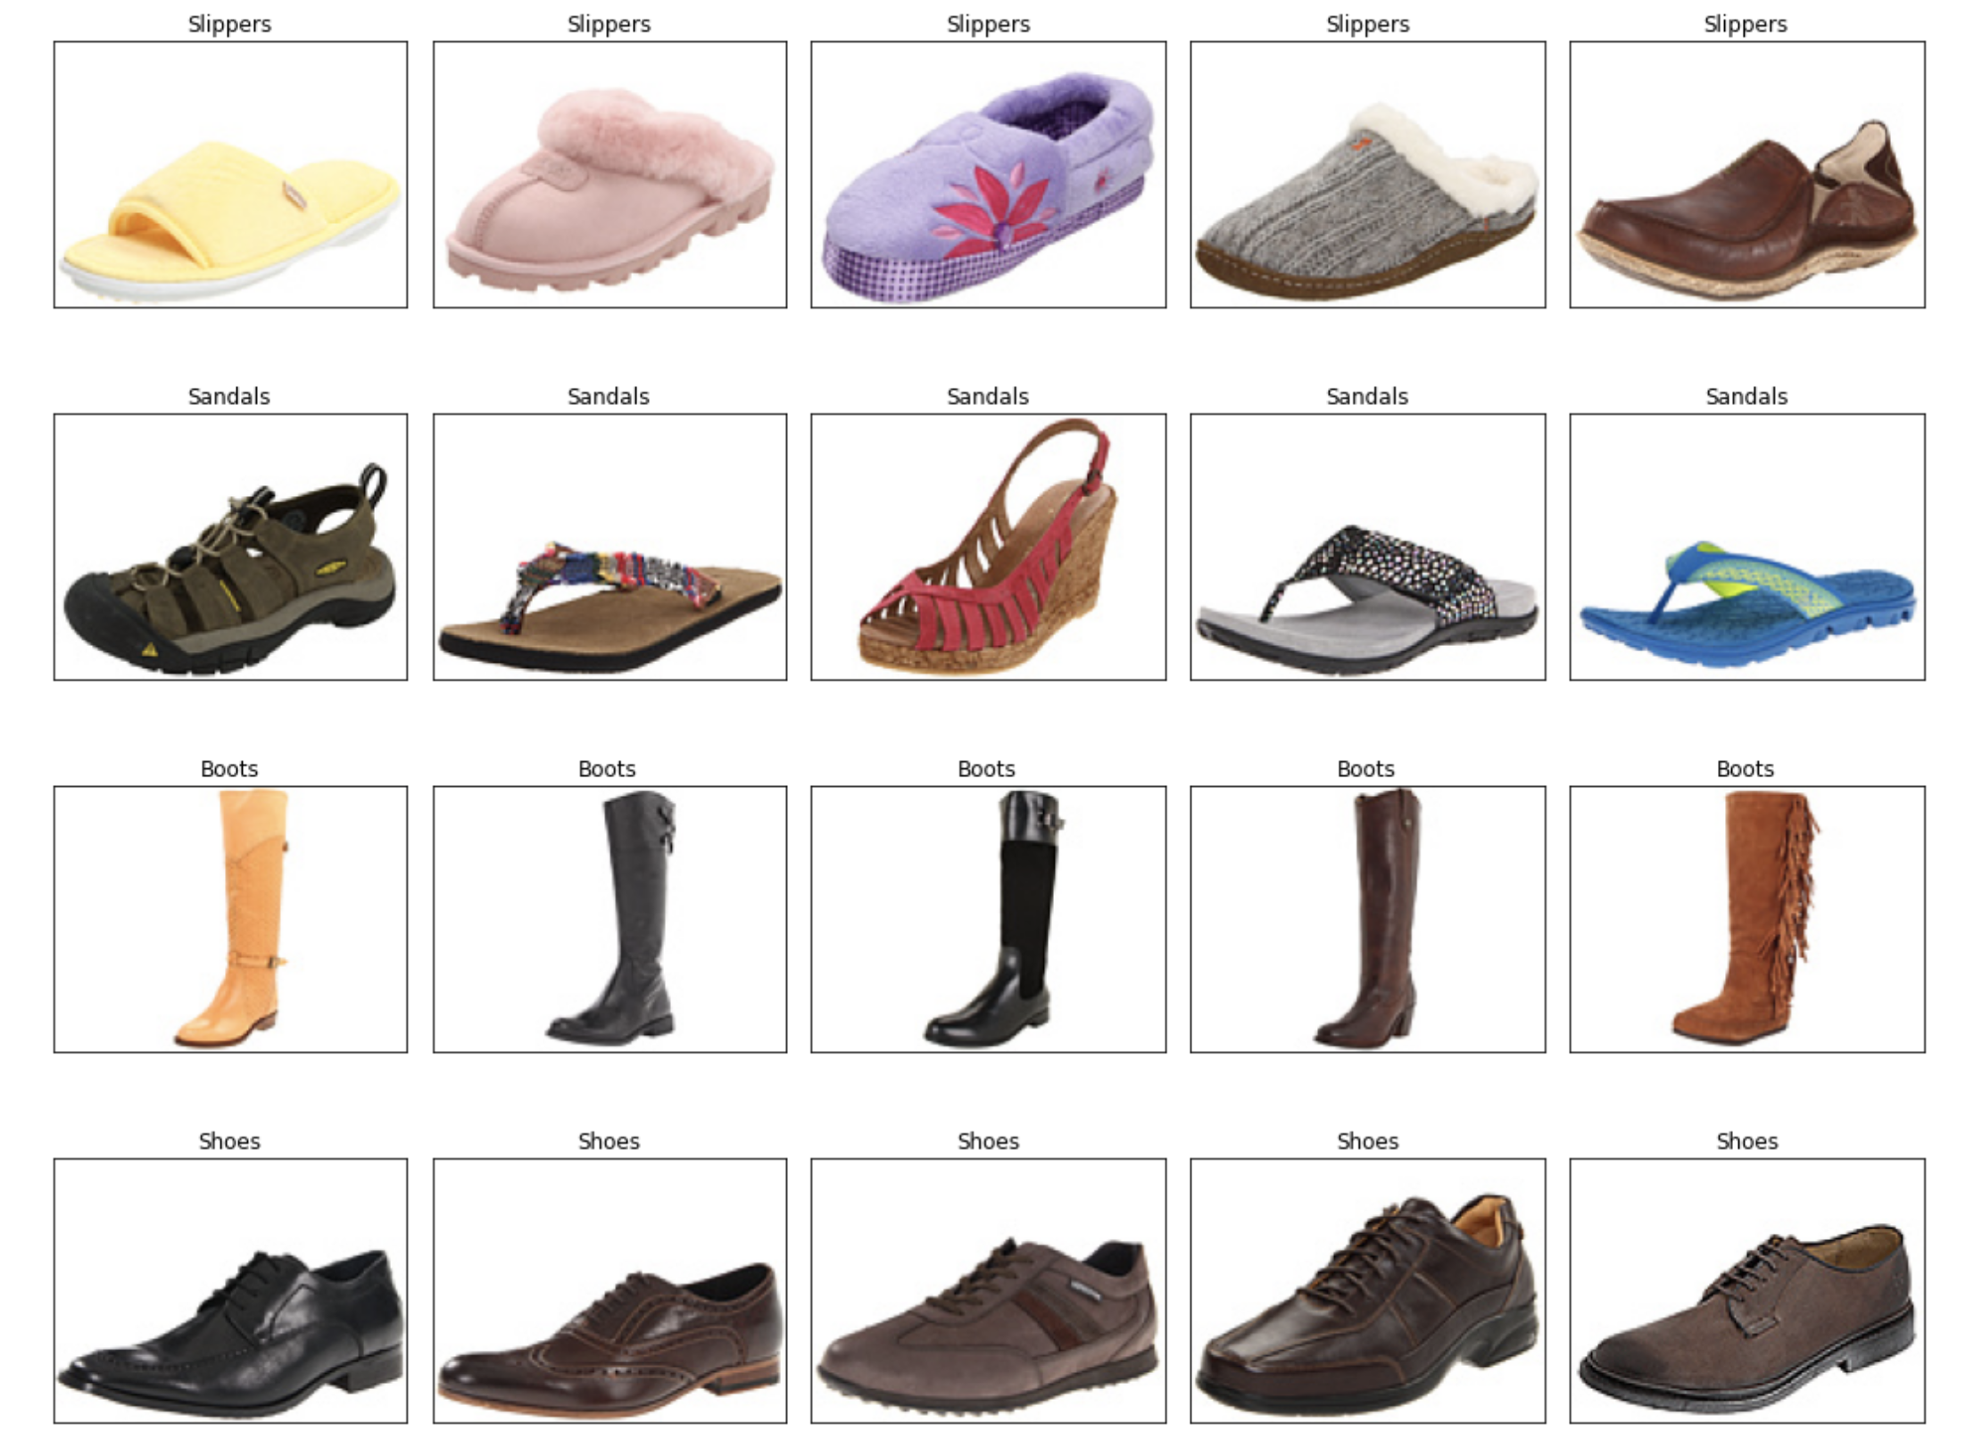
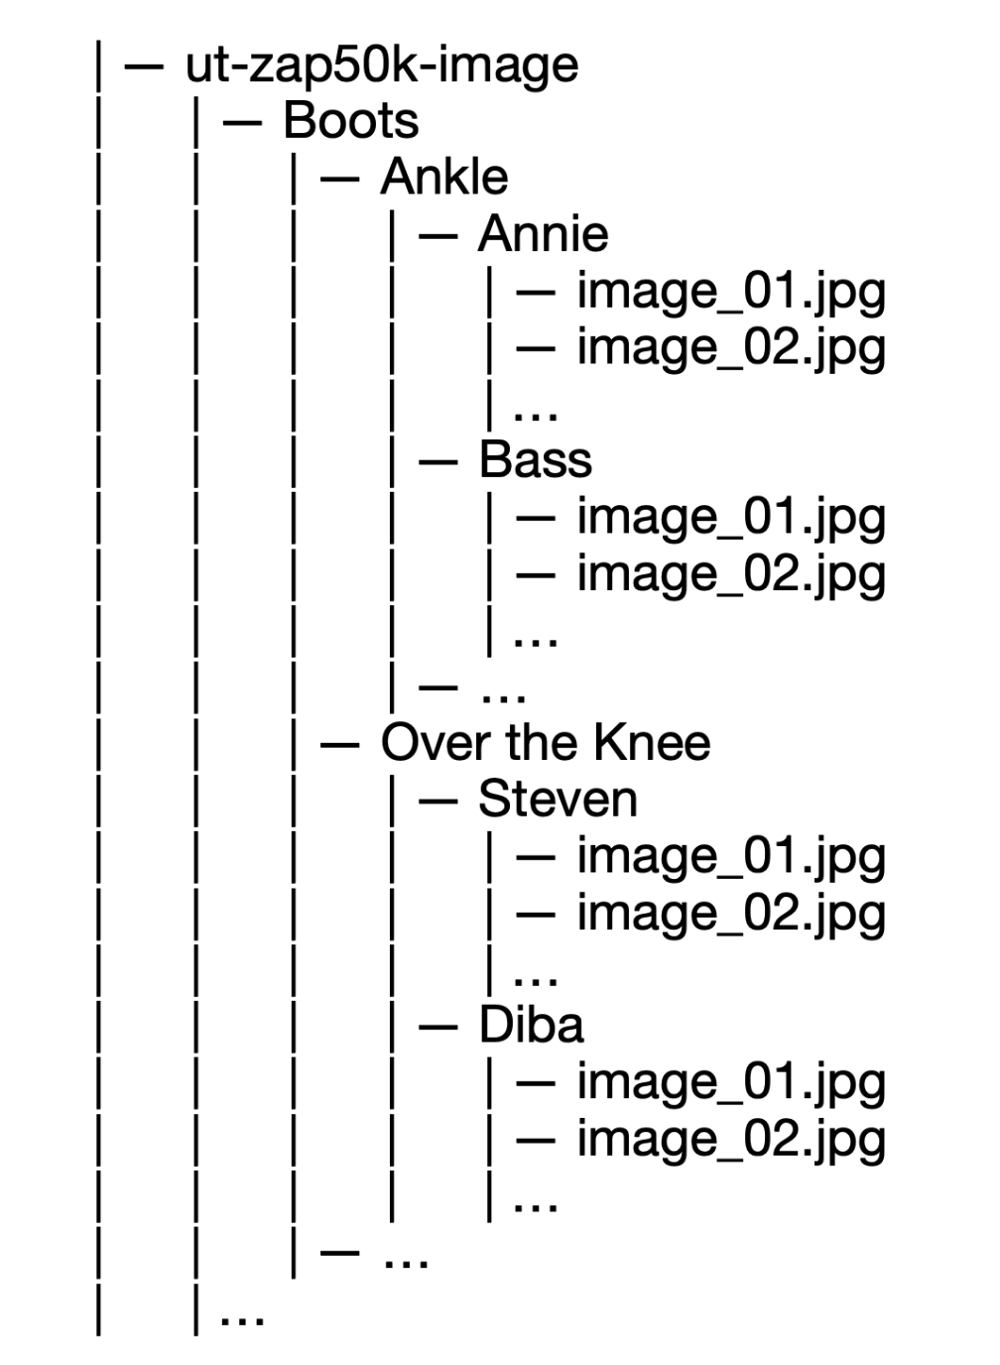
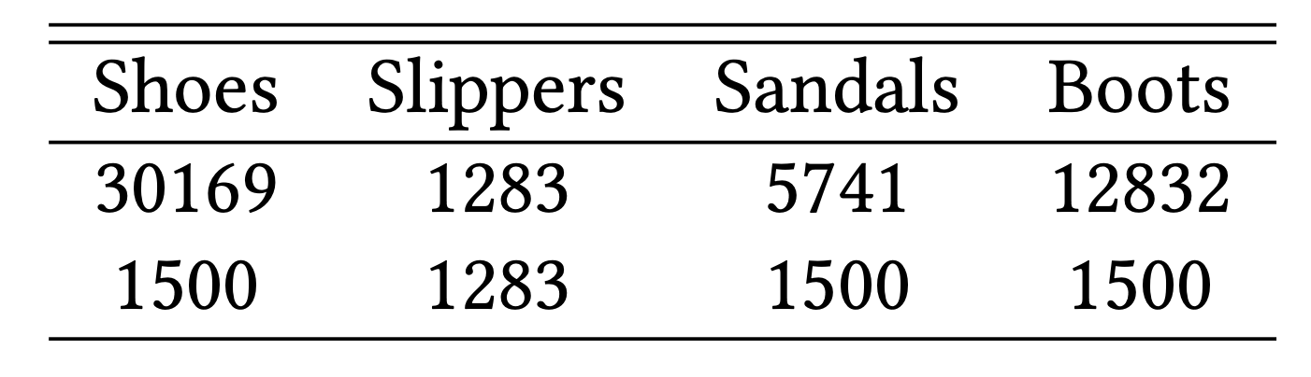
Dataset

Slide 5
Transfer Learning

Slide 6
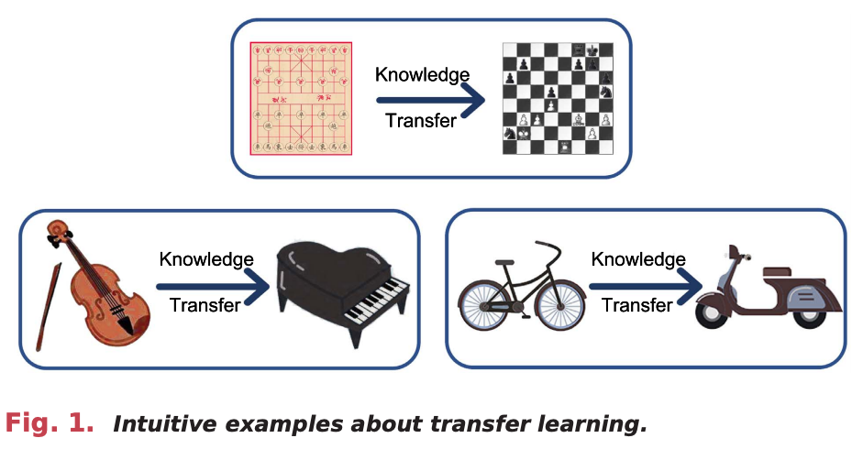
Transfer Learning

Slide 7
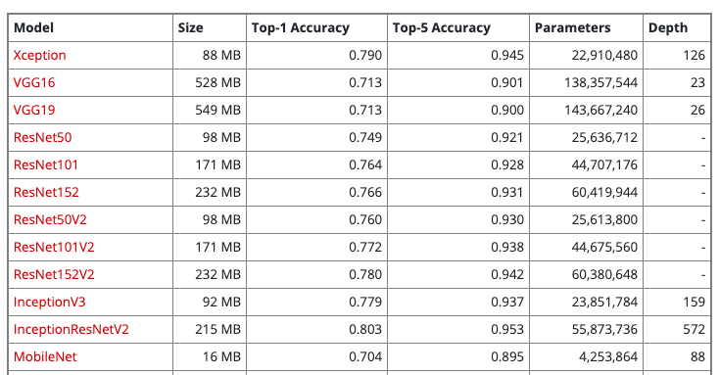
Xception

Slide 8
Xception

Slide 9
Xception
Training dataset
Validation dataset
Xception
Transfer
Xception
Testing dataset
Output / Classes
CONV1
CONV2
Output / Classes

Slide 10
Siamese Network

Slide 11
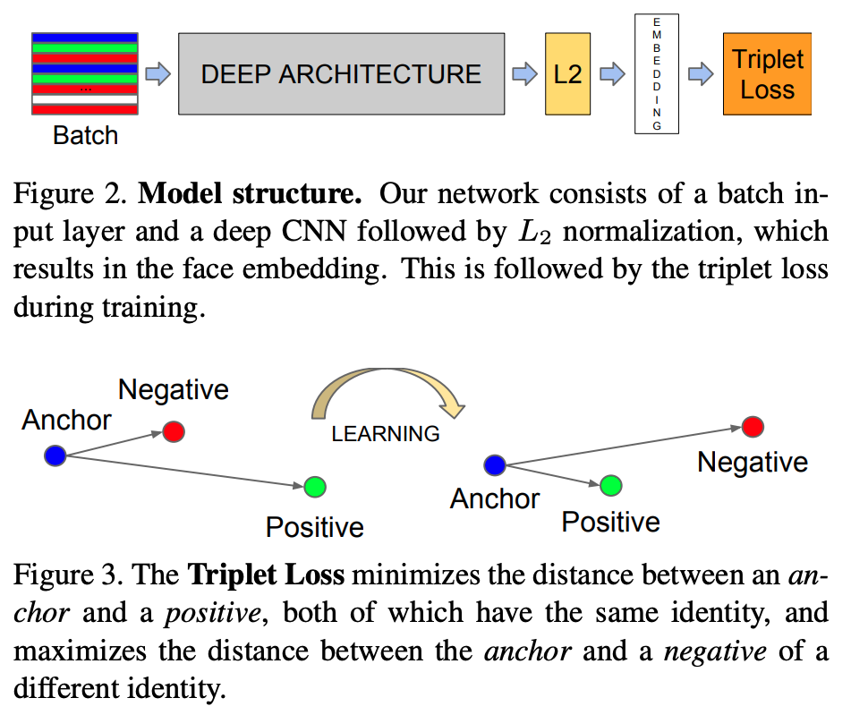
Siamese Network
Loss
CNN
Classes
Our network consists of a batch input layer and a deep CNN followed by L2 normalization, which results in the image embedding. This is followed by a loss function during training. Furthermore, we add one more CNN layer to generate classes output.
SCHOOL OF - to apply in all slides at the same time edit in Insert > Header & Footer

Slide 12
Typical CNN Architecture

Slide 13
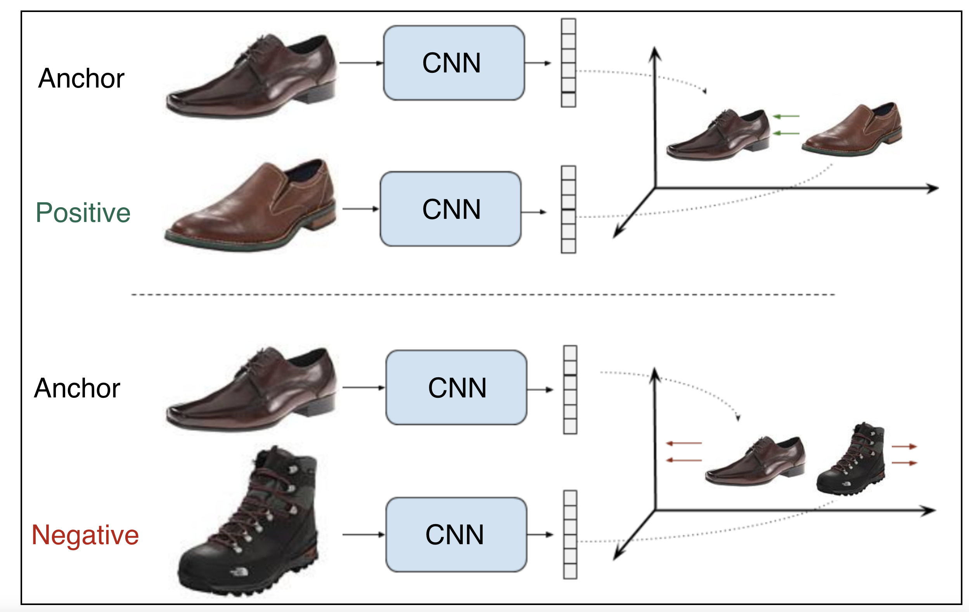
Contrastive Loss
Shared weights
pull
push
Shared weights
SCHOOL OF - to apply in all slides at the same time edit in Insert > Header & Footer

Slide 14
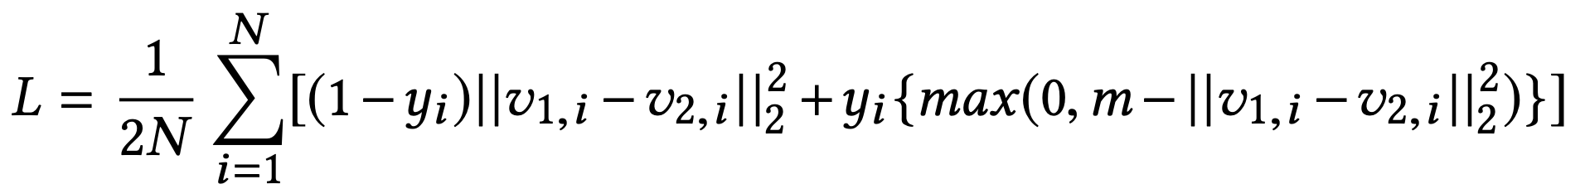
Contrastive Loss
Assume x_{a,i},x_{p,i},x_{n,i} are the anchor sample, positive sample and negative sample in a triplet respectively. v_{a,i},v_{p,i},v_{n,i} are their correspondent embedding vectors. y_{i} is the binary label that equals 1 for a positive pair and 0 for a negative pair. m is the marge and N is the batch size.
SCHOOL OF - to apply in all slides at the same time edit in Insert > Header & Footer

Slide 15
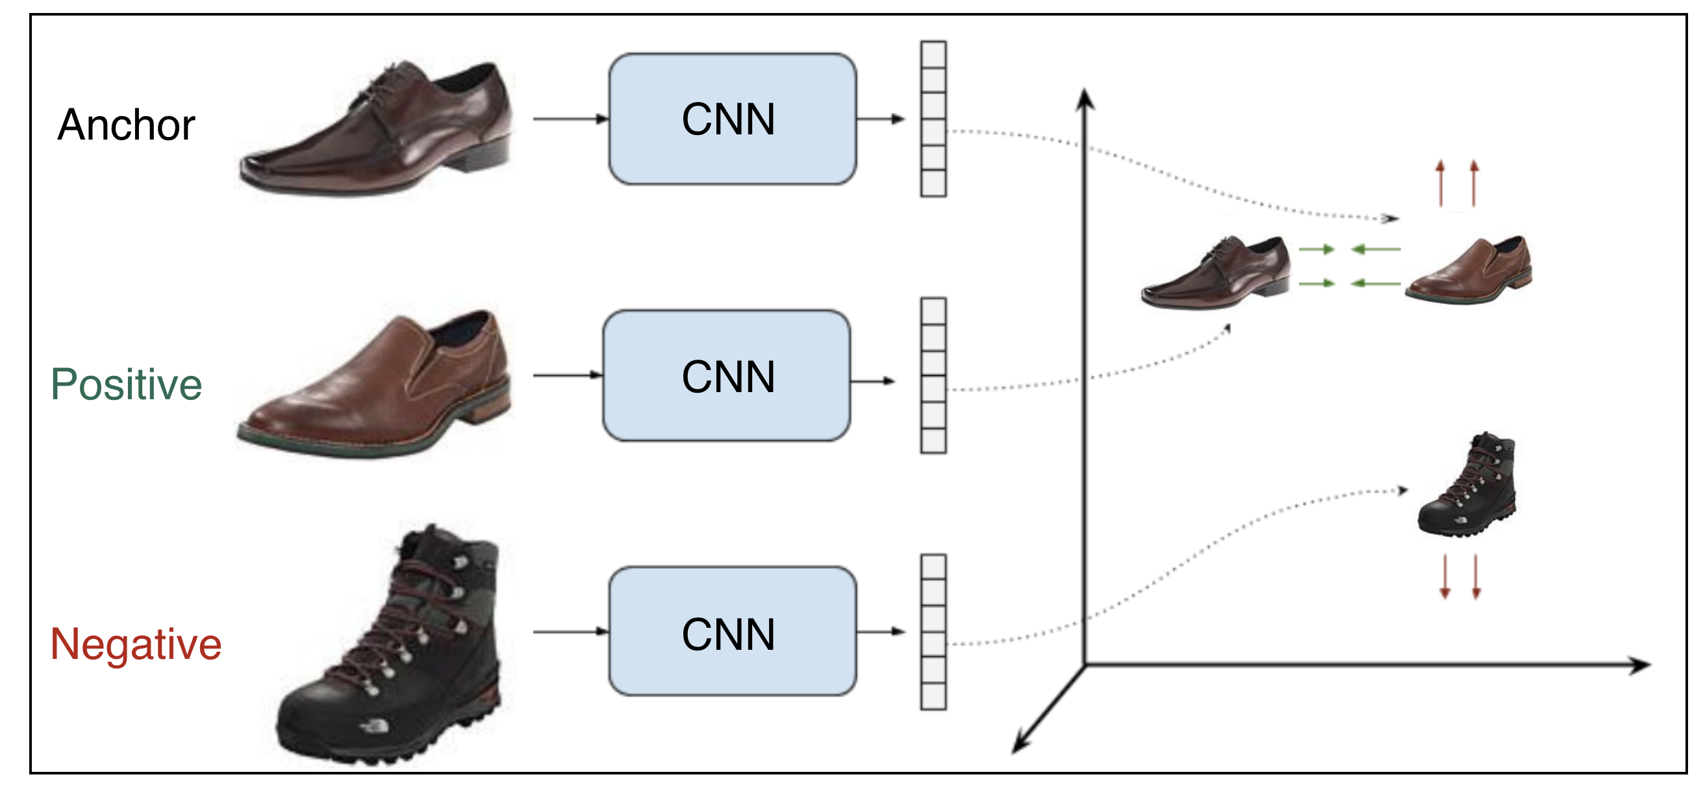
Triplet Loss
Shared weights
pull
push
Shared weights
SCHOOL OF - to apply in all slides at the same time edit in Insert > Header & Footer

Slide 16
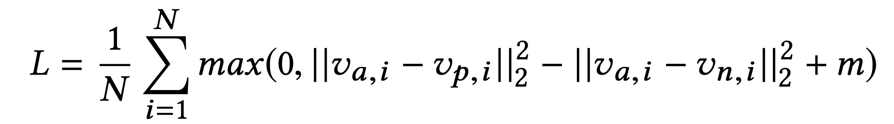
Triplet Loss
Assume x_{a,i},x_{p,i},x_{n,i} are the anchor sample, positive sample and negative sample in a triplet respectively. v_{a,i},v_{p,i},v_{n,i} are their correspondent embedding vectors. m is the marge and N is the batch size.
SCHOOL OF - to apply in all slides at the same time edit in Insert > Header & Footer

Slide 17
Triplet Loss
SCHOOL OF - to apply in all slides at the same time edit in Insert > Header & Footer

Slide 18
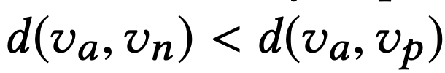
Triplet Mining
Easy negatives
Semi-hard negatives
Hard negatives
margin
A
P
SCHOOL OF - to apply in all slides at the same time edit in Insert > Header & Footer

Slide 19
Implementation

Slide 20
Pairs

Slide 21
Evaluation

Slide 22
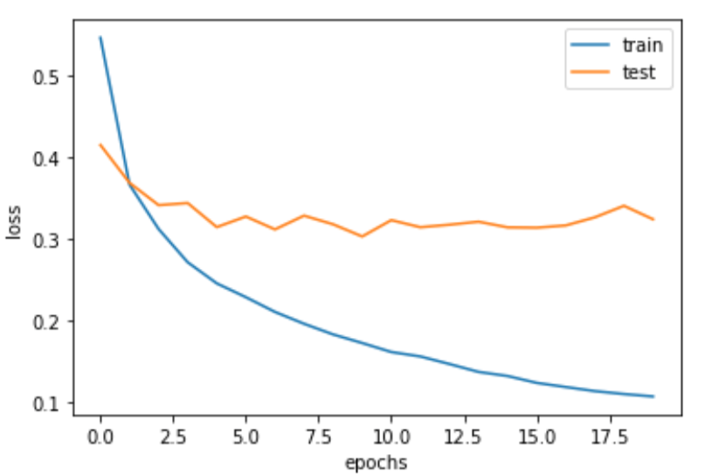
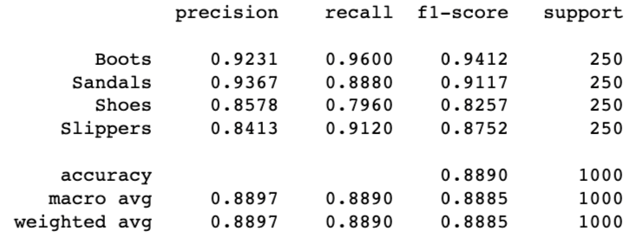
Transfer Learning

Slide 23
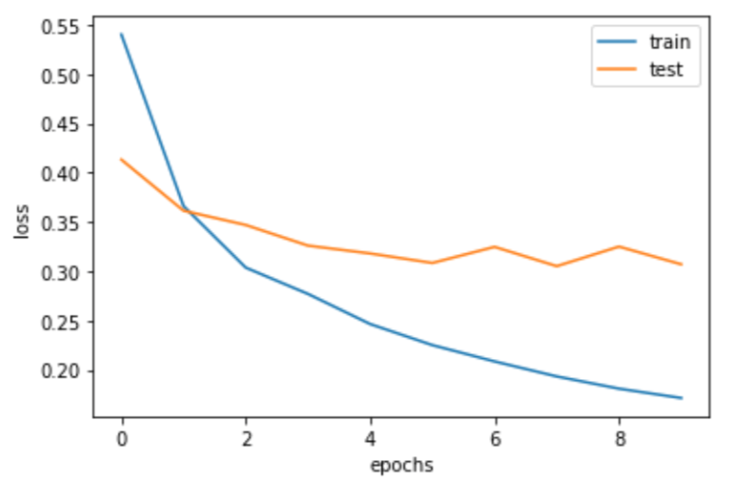
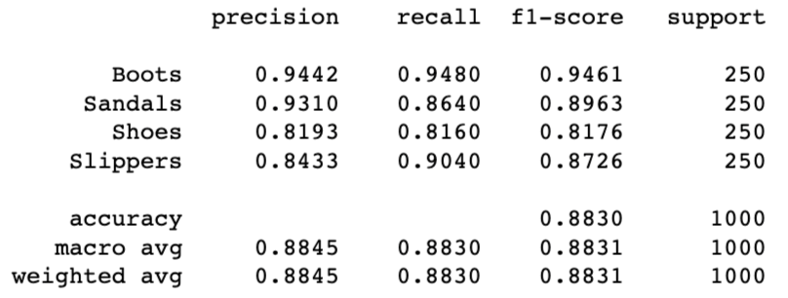
Transfer Learning 2

Slide 24
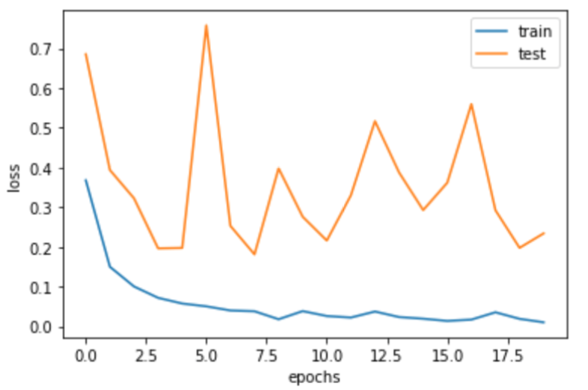
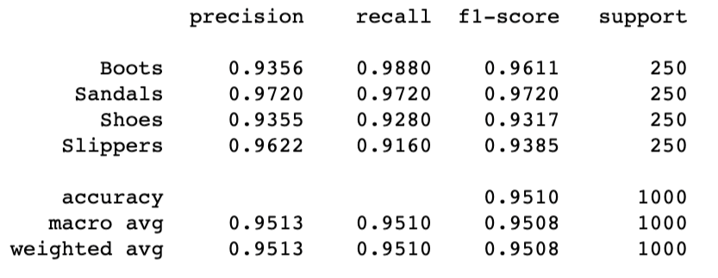
Transfer Learning 3

Slide 25
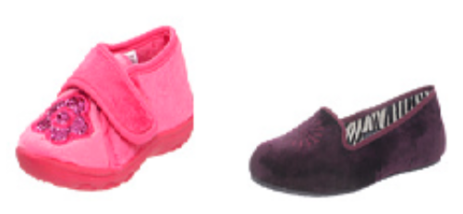
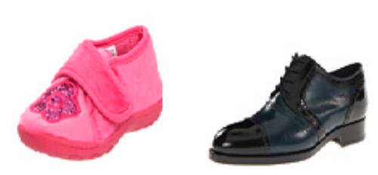
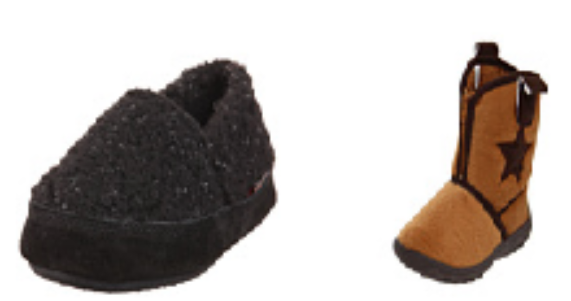
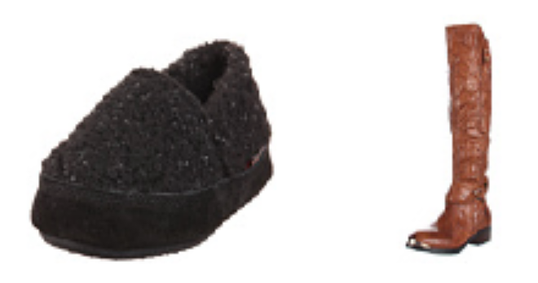
Distance
Distance: 0.10
Distance: 0.84
Distance: 0.73
Distance: 0.97

Slide 26
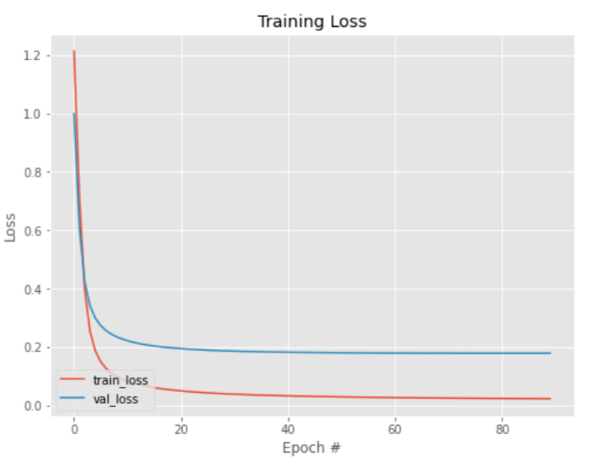
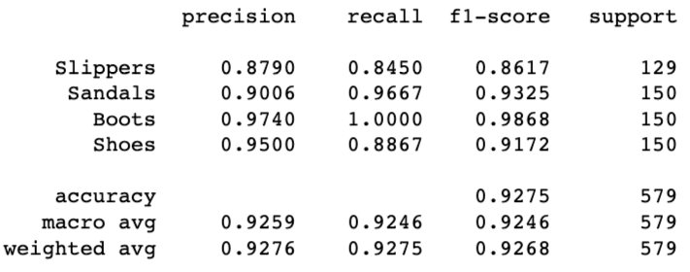
Contrastive Loss

Slide 27
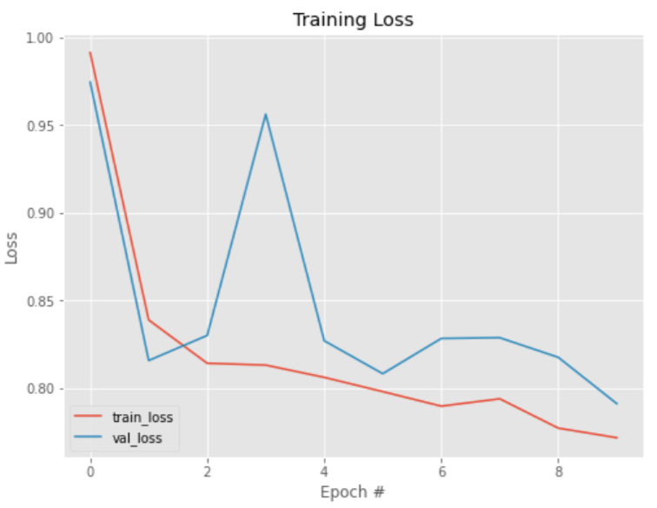
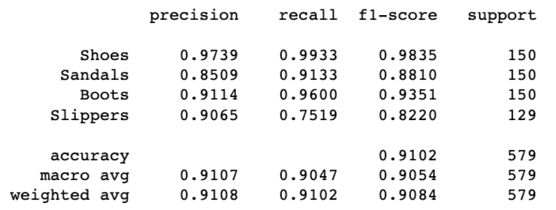
Triplet Loss

Slide 28
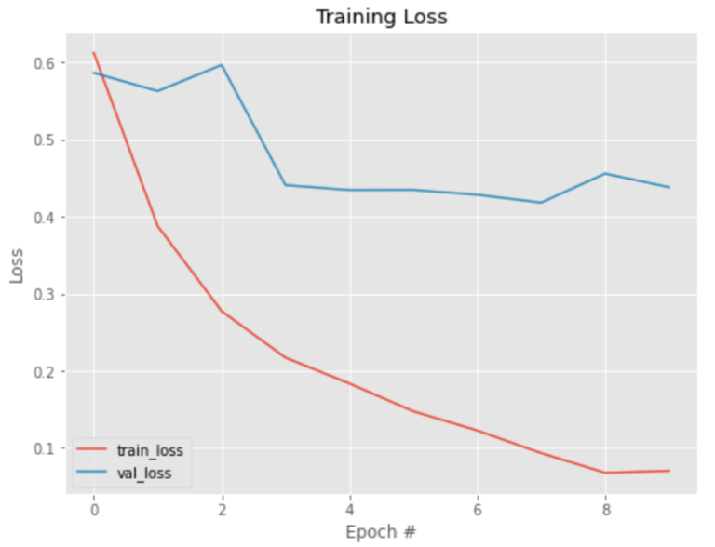
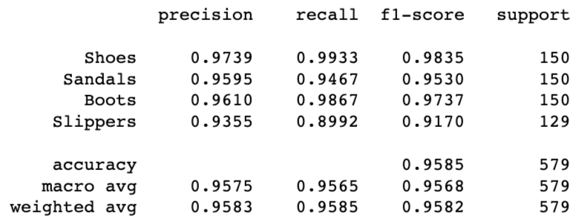
Triplet Loss + Transfer Learning

Slide 29
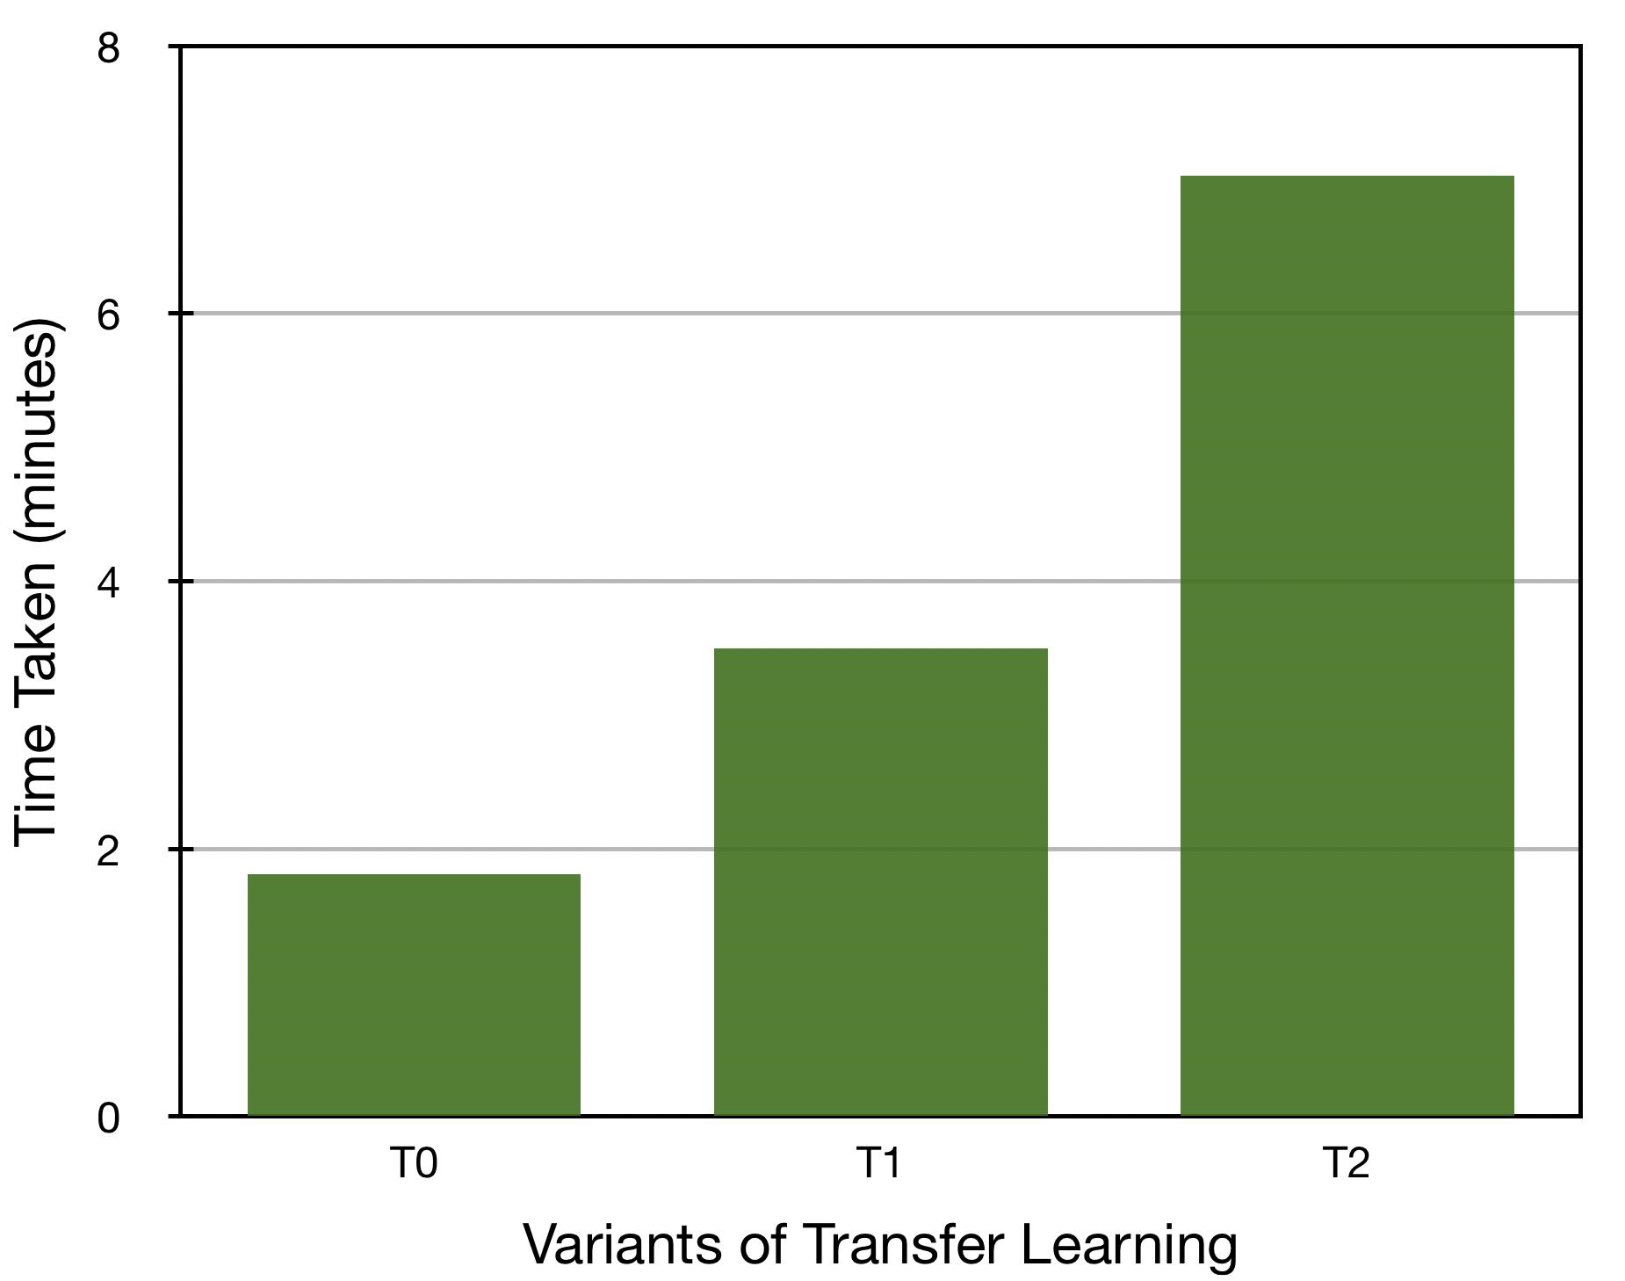
Comparison of Transfer Learning

Slide 30
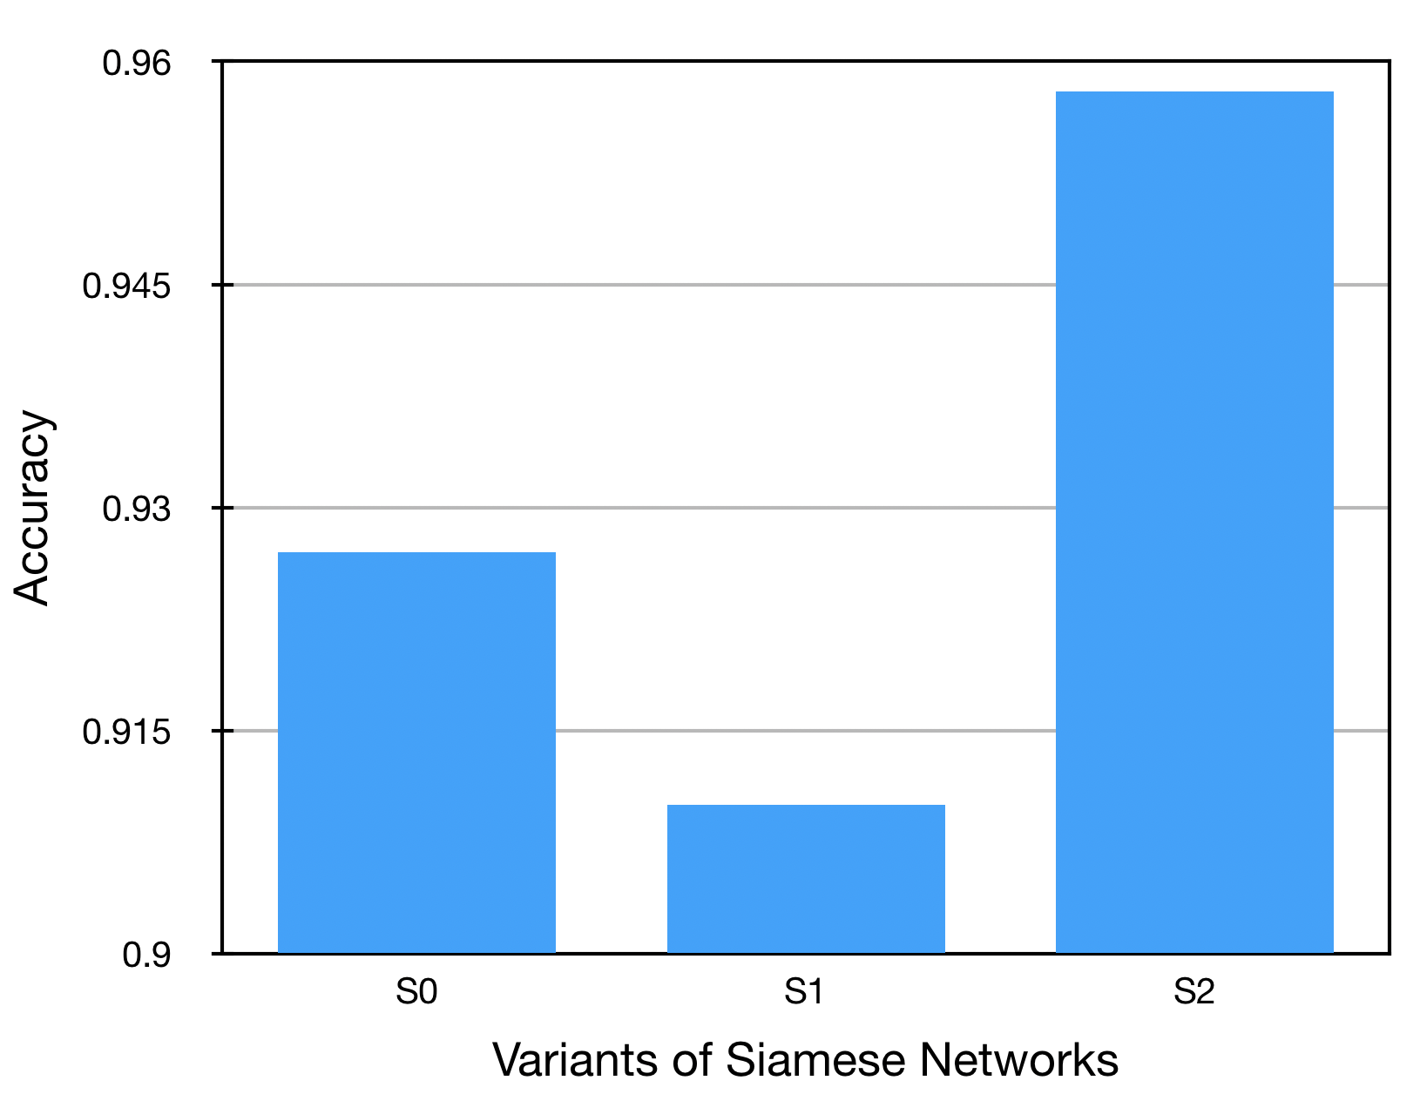
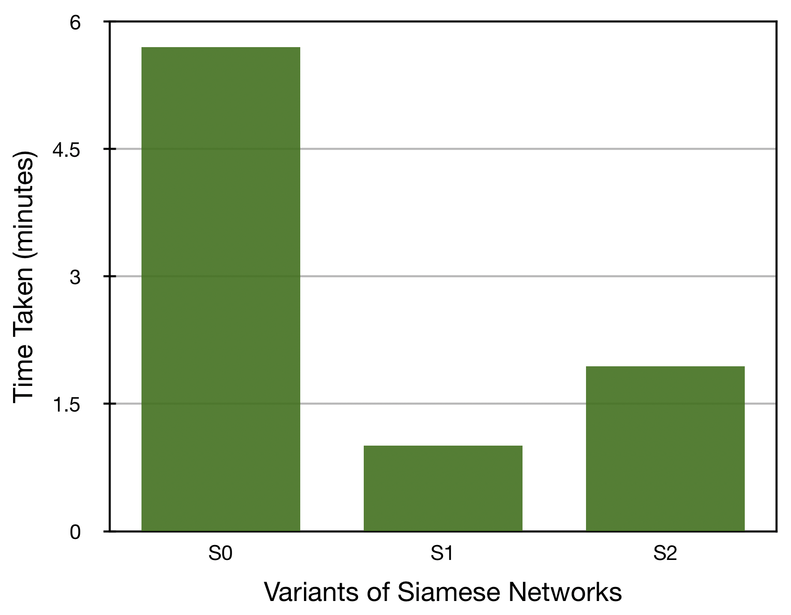
Comparison of Siamese Network

Slide 31
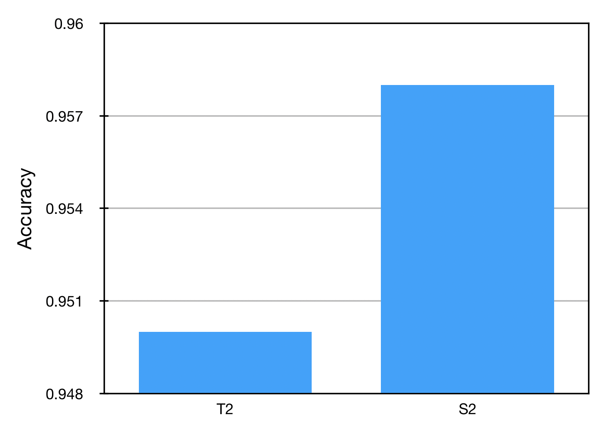
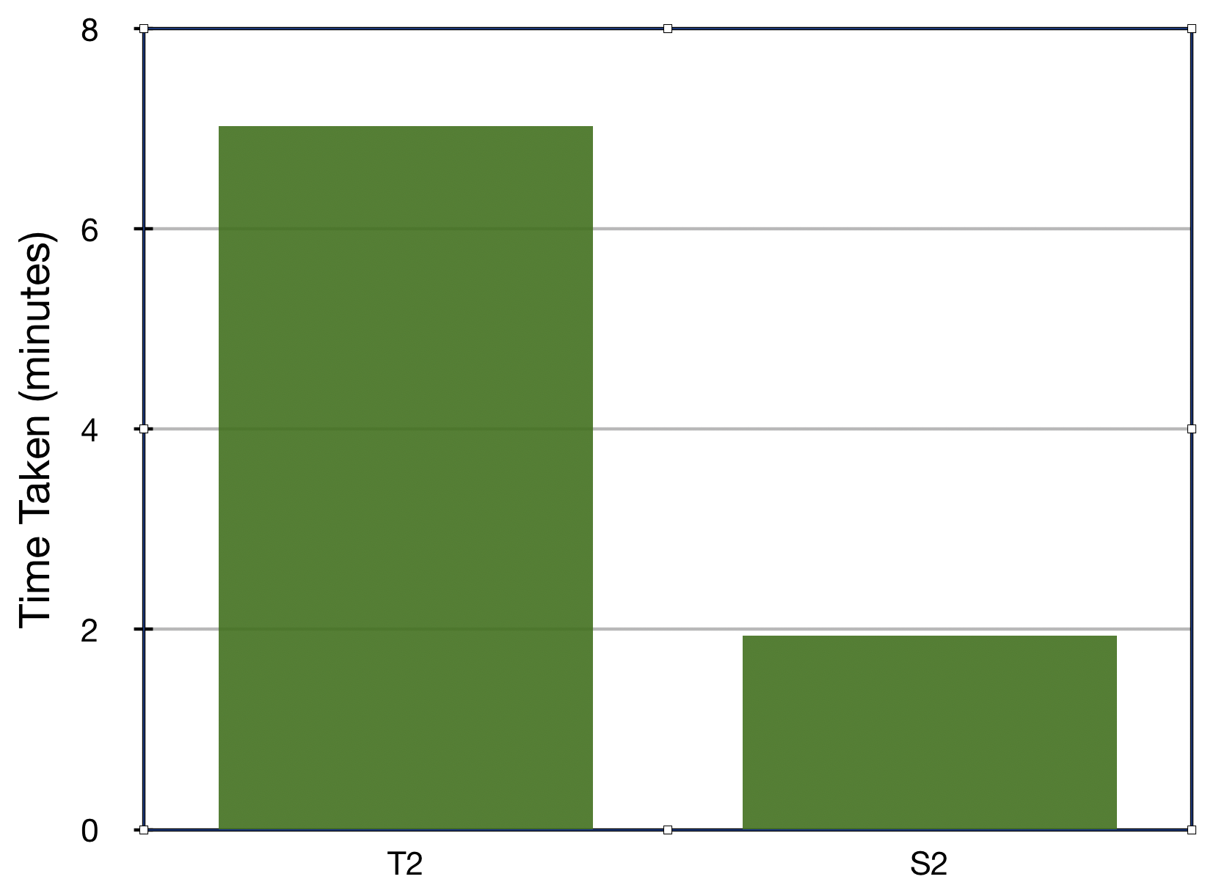
Comparison best models

Slide 32
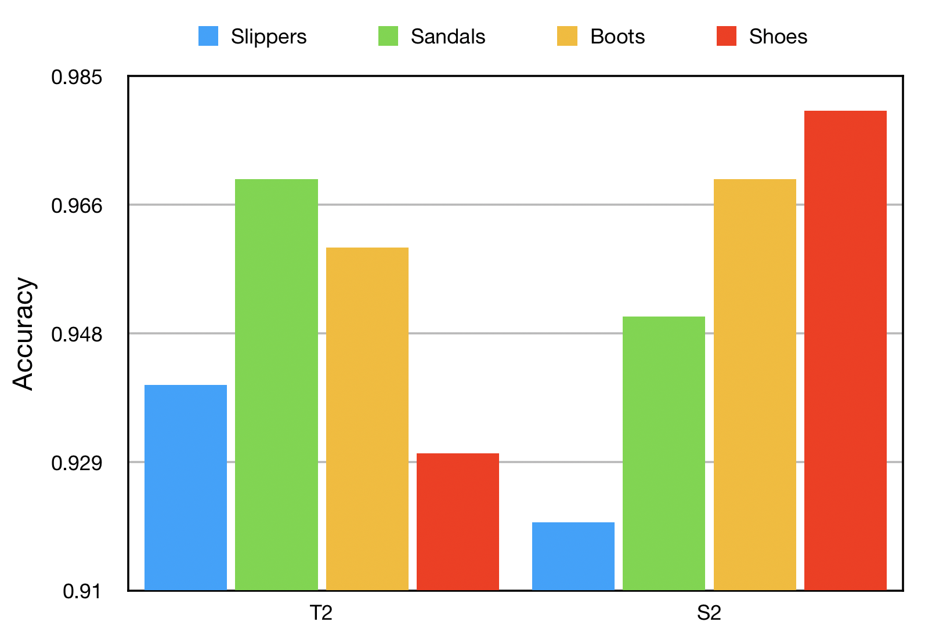
Analyze each class

Slide 33
Thank you!

